Slide 1

Introduction to Software Business Product management
Week 1 Day 3
Led by:
Emily Crose
Oakland University
Notes:
Include VLANs?

Slide 2





Day 2 recap

Slide 3


Question or Clarifications?

Slide 4

Networking

Slide 5

What Does Your Home Network Look Like?
Notes:
Let’s have a quick discussion. What does your home network look like? What kind of devices are on your network?

Slide 6
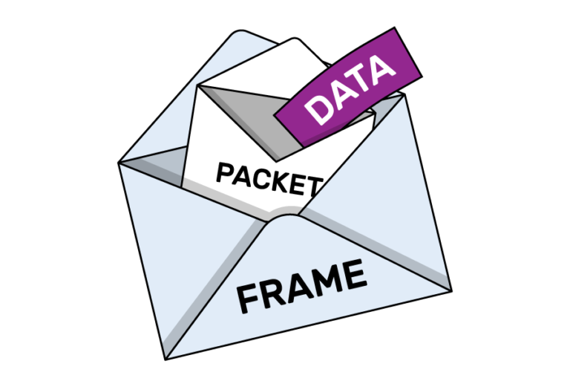
Packets

Slide 7
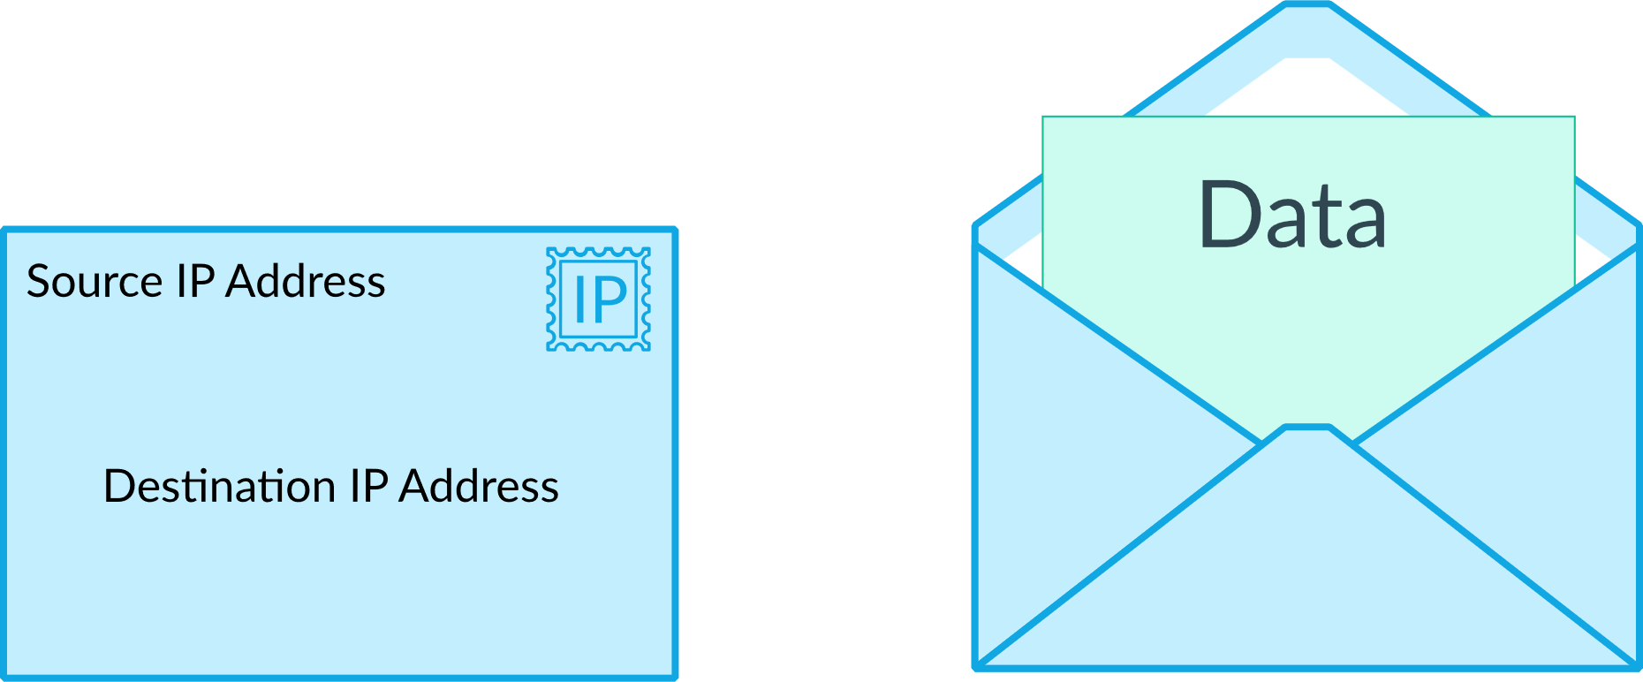

Slide 8
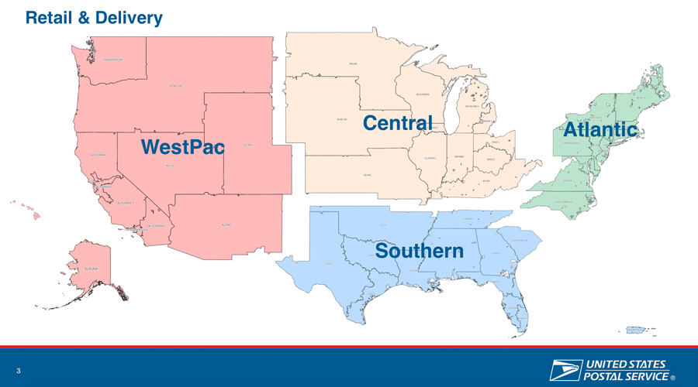

Slide 9
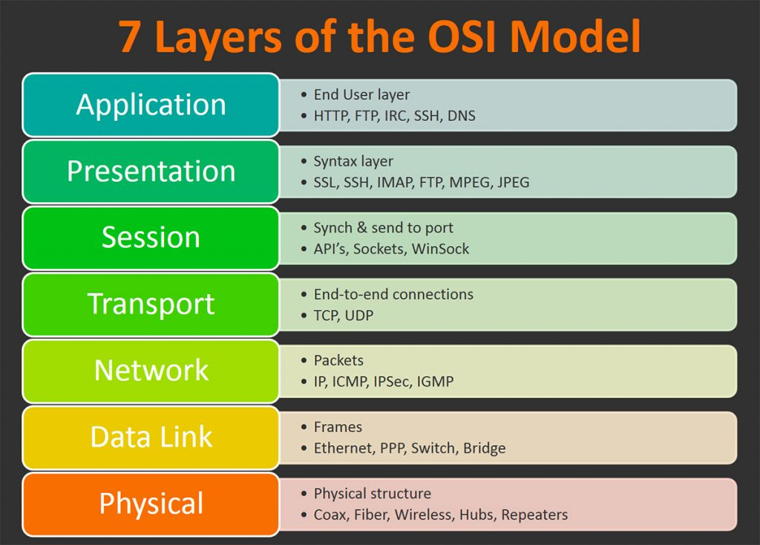

Slide 10
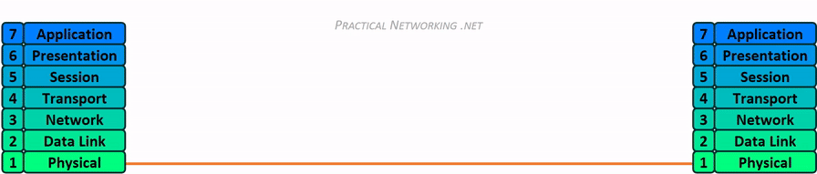
Network Transmission

Slide 11

Layer 1- Physical
Media Layer

Slide 12
Networking Hardware
Purpose
Provides a physical medium for transporting raw information
Wireless Antenna
Cat5 (Ethernet) Cables
Coaxial Cables
Fiber Optic Cables
Network Hubs
Network Repeaters

Slide 13

Layer 2 - Data Link
Media layer

Slide 14
Layer 2
Purpose
Provides error-free transfer of data frames from one node to another via the physical layer
Physical
Network Switch
Network Bridge
Logical
“Frames”

Slide 15
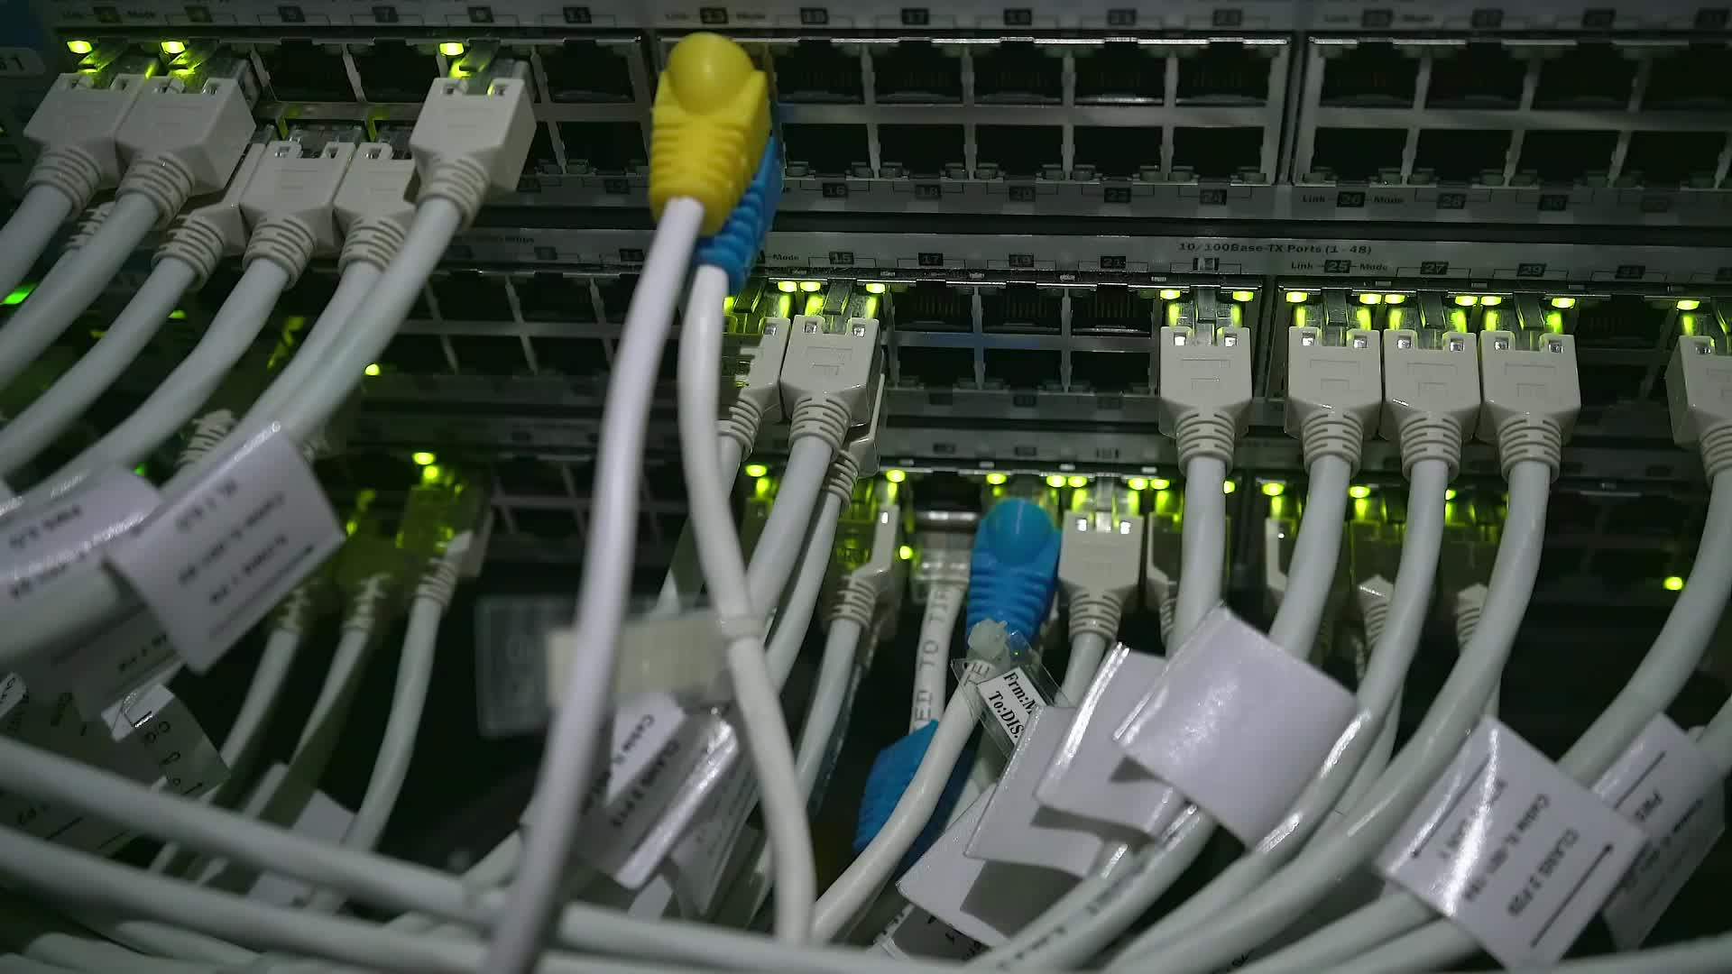
Layer 3 - Network
Media Layer

Slide 16
Layer 3
Purpose
Controls the operations of the subnet.
Decides which physical path data will take
Physical
Router
Logical (Protocols)
IP
ICMP
IPSec
IGMP

Slide 17
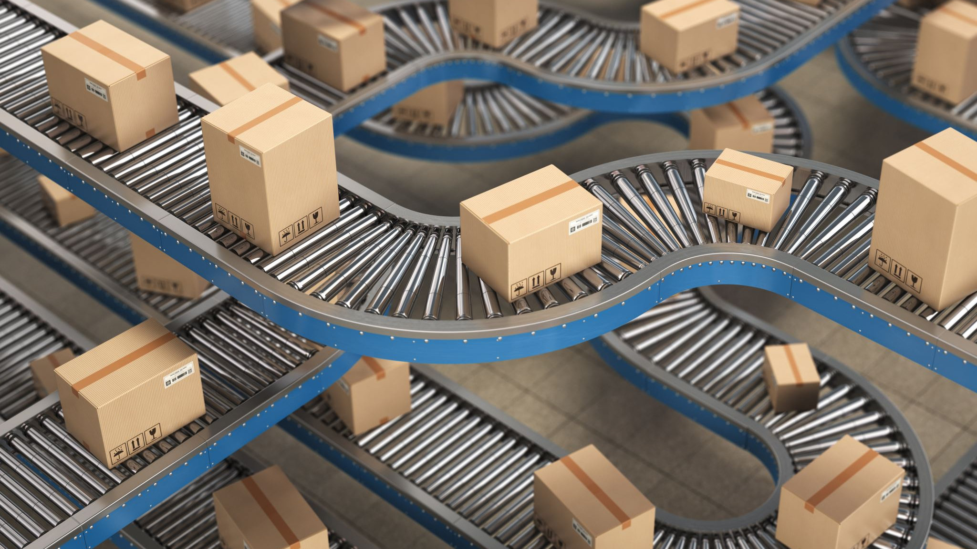
Layer 4 - Transport
Host Layer

Slide 18
Layer 4
Purpose
Ensures that messages are delivered in sequence without losses, errors or duplications
Logical
TCP
UDP

Slide 19
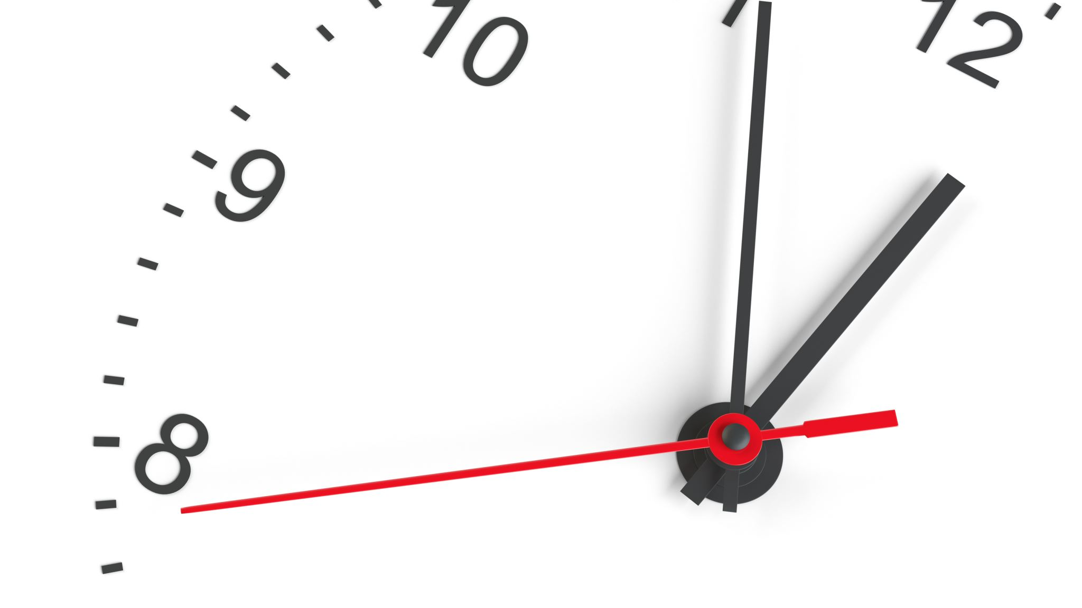
10 minute break

Slide 20
TCP VS. UDP

Slide 21
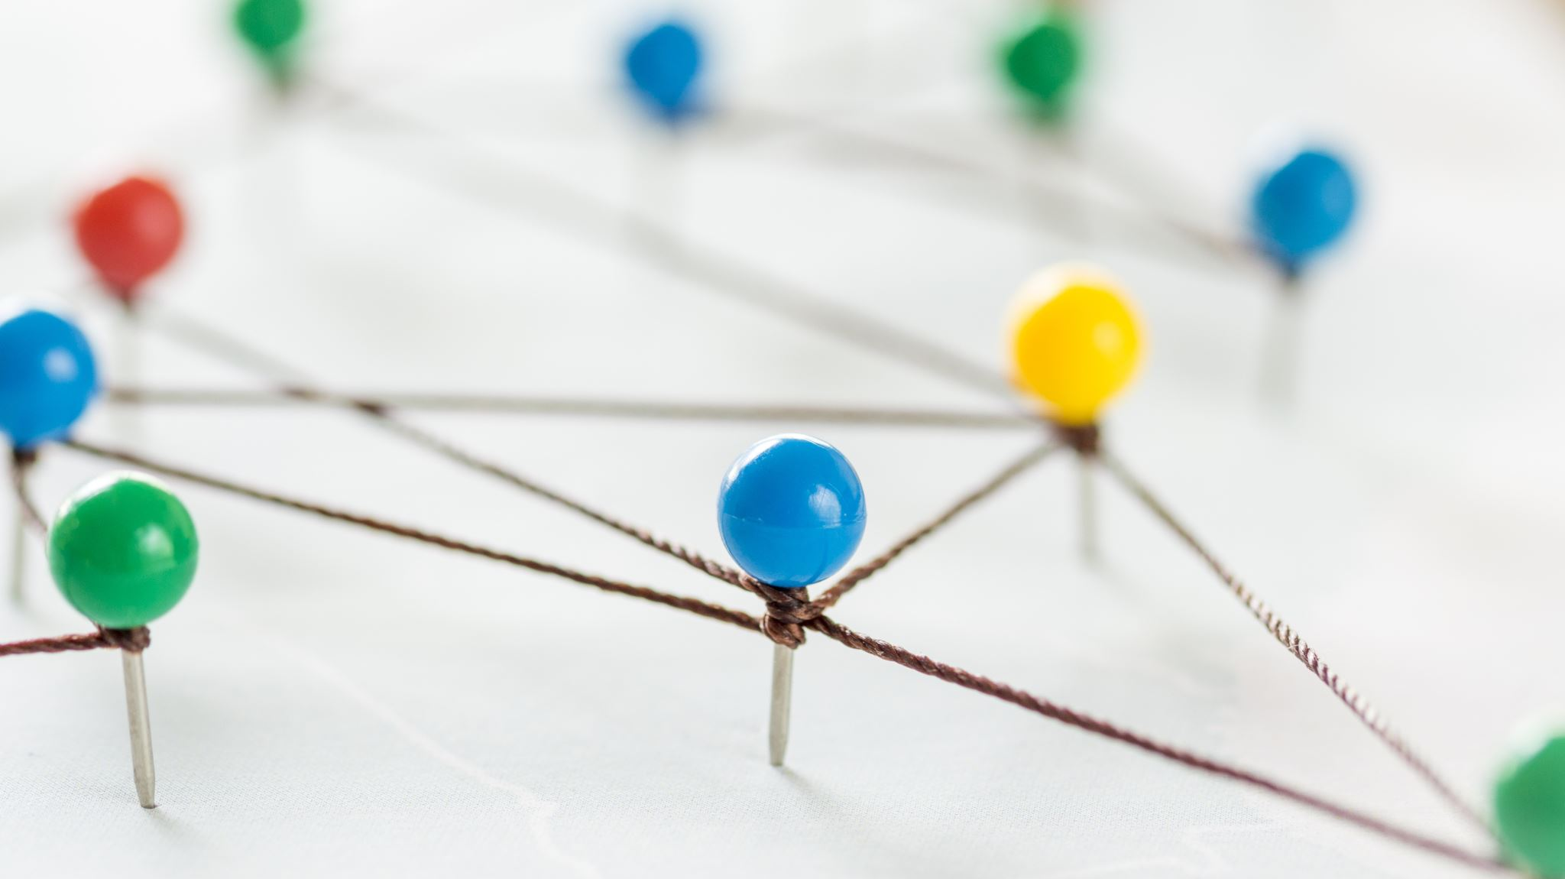
Stateful vs. Stateless Networking

Slide 22
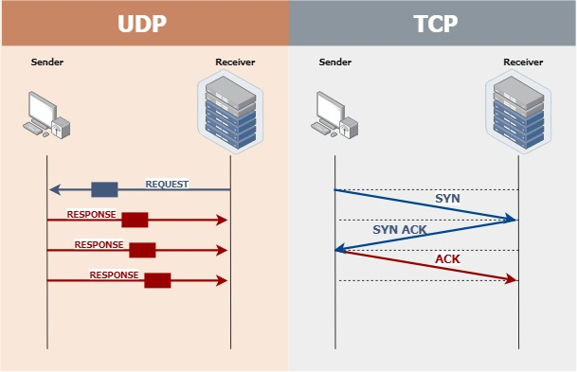

Slide 23
TCP Handling

Slide 24
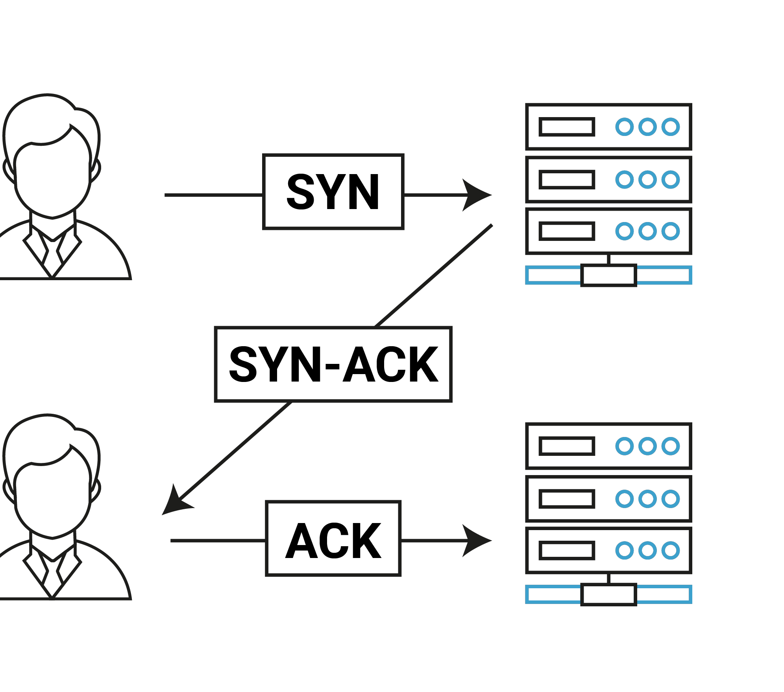
TCP 3-Way Handshake

Slide 25
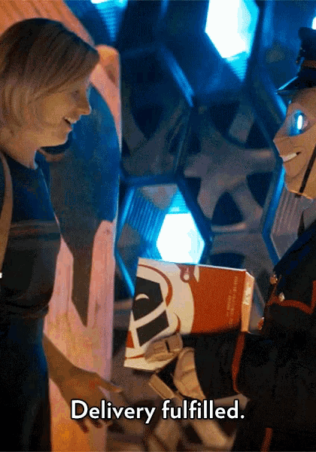
Explain TCP In A Gif

Slide 26
UDP Handling

Slide 27
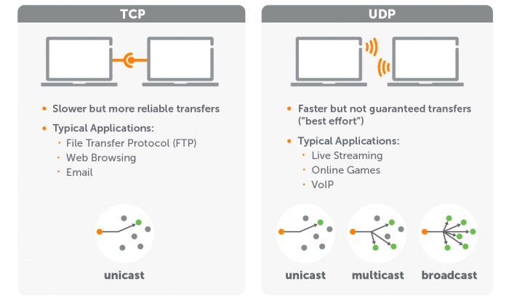

Slide 28

Explain UDP In A Gif

Slide 29
Discussion: TCP Apps & UDP Apps
Moodle
TCP or UDP?
VoIP
TCP or UDP?
YouTube
TCP or UDP?
SWIFT Money Transfers
TCP or UDP?

Slide 30
Layer 5 – Session
Host layer

Slide 31
Layer 5
Purpose
Allows the establishment of sessions between processes
Protocols
RPC
SQL
NFS
Netbios

Slide 32

Layer 6 – Presentation
Host layer

Slide 33
Layer 6
Purpose
Formats data bound for the application layer (layer 7)
Protocols
JPG
ASCII
ANSI
GIF
WEBP

Slide 34
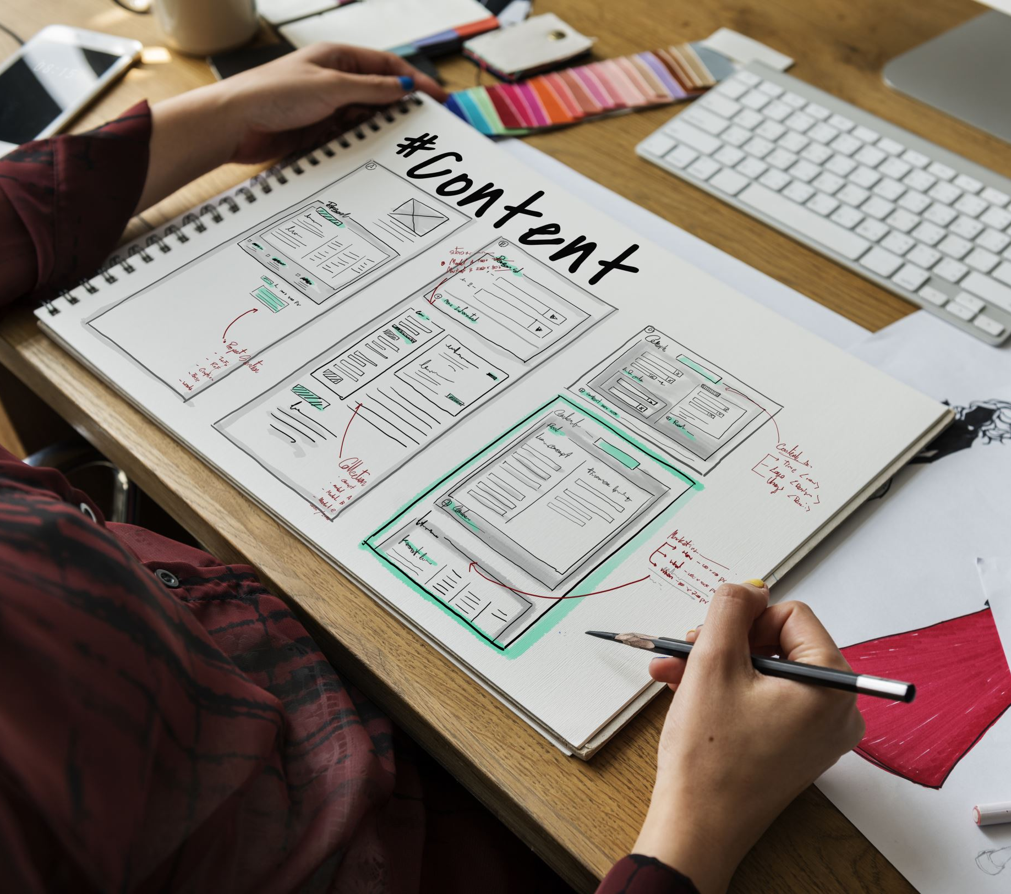
Layer 7 – Application
Host layer

Slide 35
Layer 7
Purpose
Interface layers for users to access network resources
Protocols
SMTP
HTTP
Wiki
Microsoft Word

Slide 36
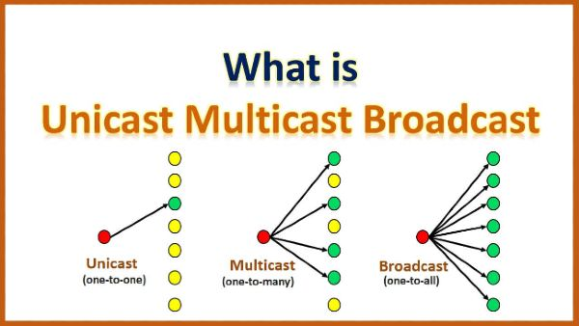

Slide 37

Shall We Play A Game?
https://static-labs.tryhackme.cloud/sites/osi-model-game/
Notes:
Let’s play a little network protocol game and see if we can remember the 7 layers of the OSI model!

Slide 38

Name Resolution

Slide 39
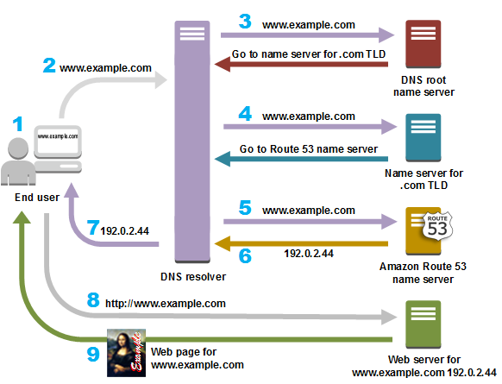
DNS

Slide 40

DNS: TCP or UDP?

Slide 41

Problem: How Do We Move Information?

Slide 42
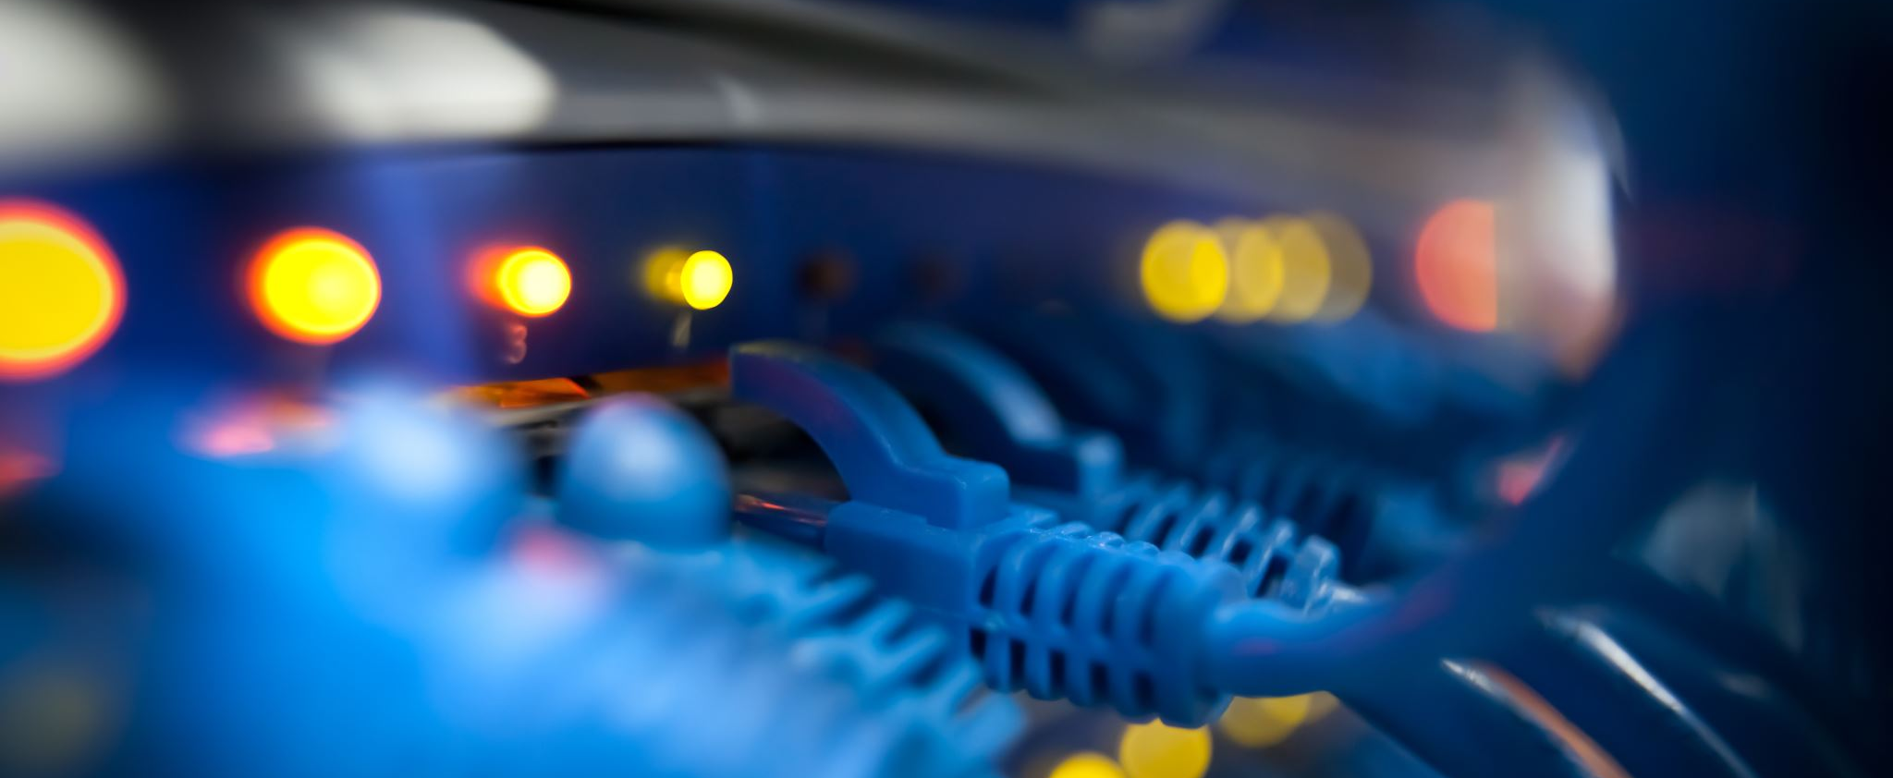
LANs and WANs

Slide 43
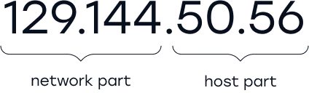
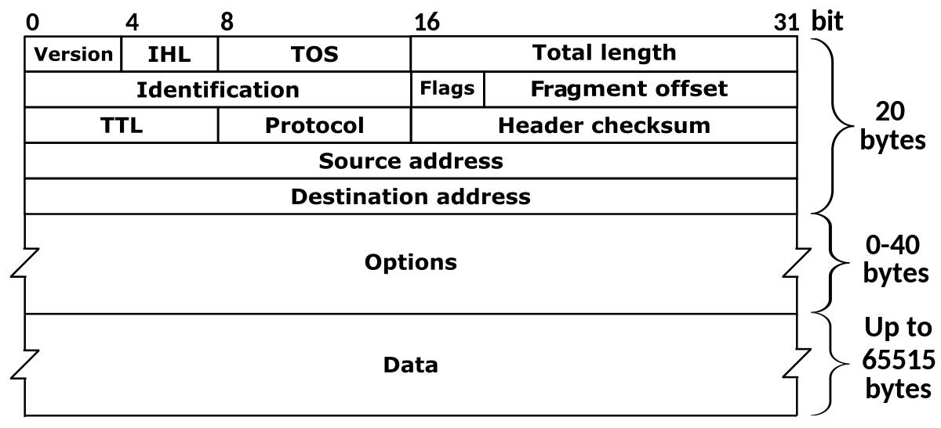
Network Operation

Slide 44
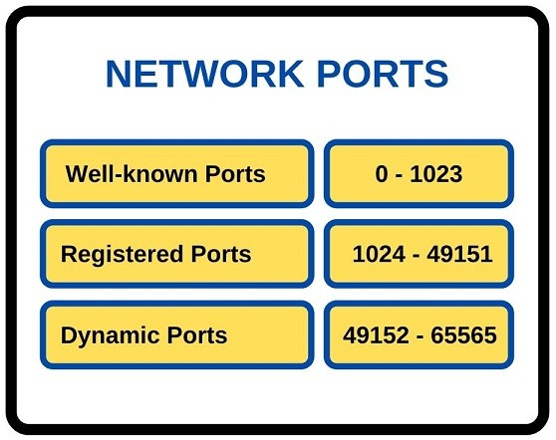
Network Ports

Slide 45
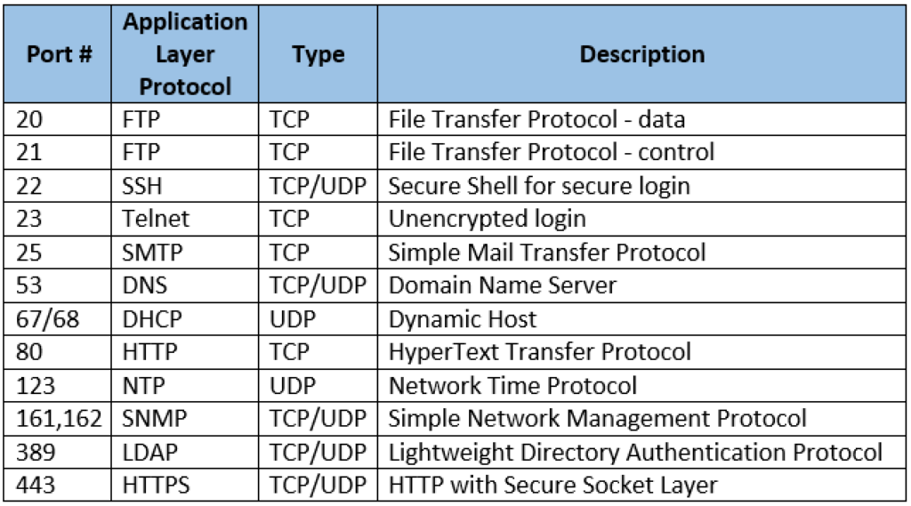
Common Ports

Slide 46
10 minute break

Slide 47
Local Area Network (LAN)
Allows connection to other nearby network-connected systems
You probably use some of these devices!
Amazon firestick
Google Chromecast
AppleTV
More protective of local information?

Slide 48
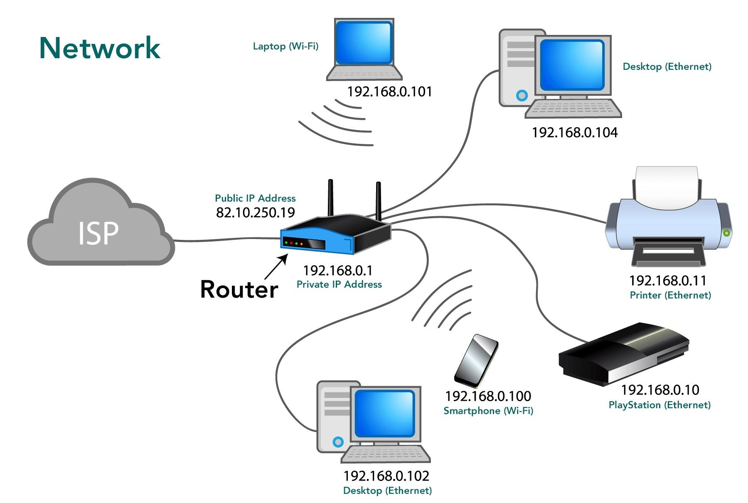
Basic Network Topology

Slide 49
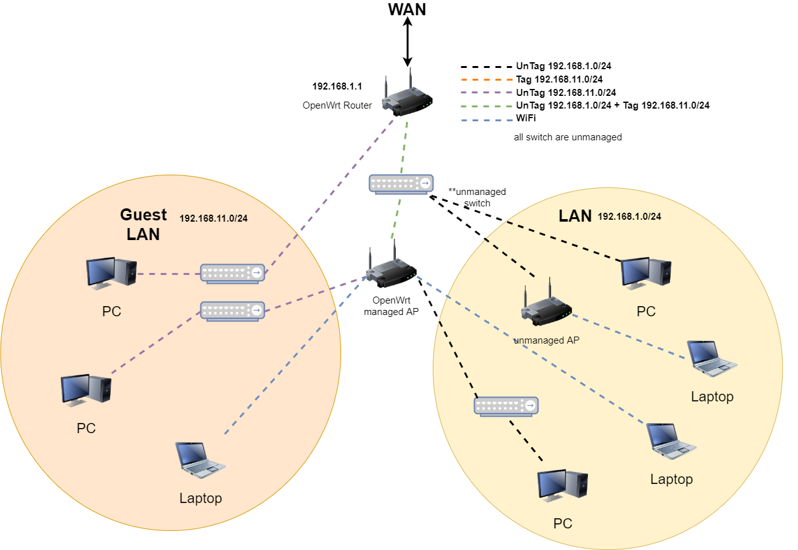

Slide 50
Wide Area Network (WAN)
Allows connection to remote hosts
Websites
Remote backups/repositories
VPNs enable access to remote LANs

Slide 51
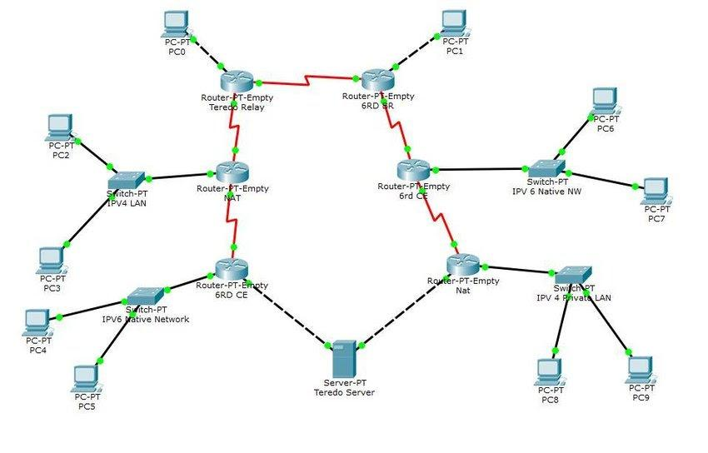
Complex Network Topology

Slide 52
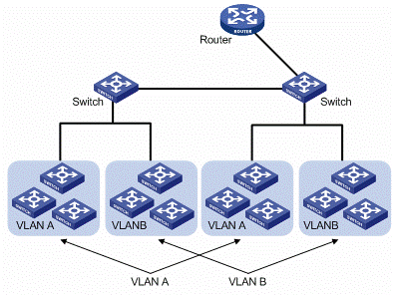
LANs and VLANs

Slide 53
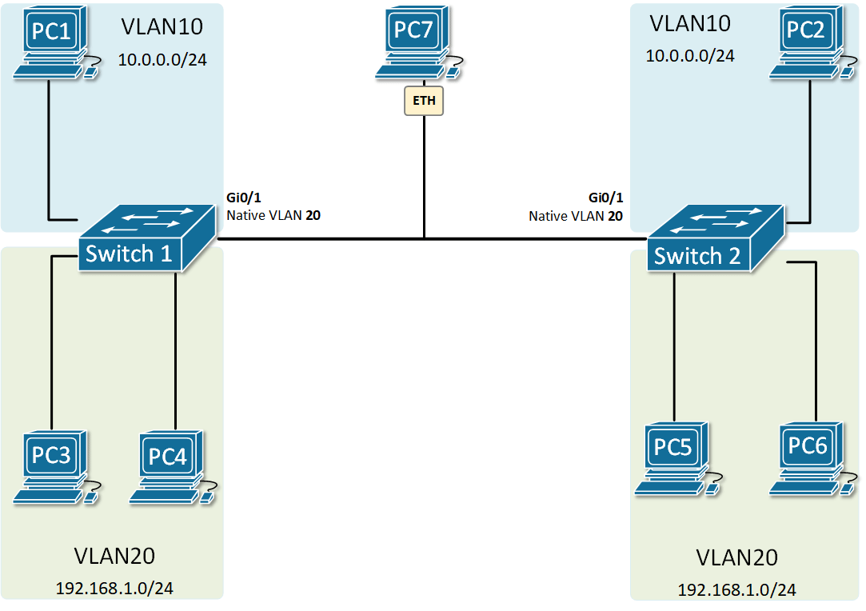
Trunk Native VLAN

Slide 54

How Do Apps Access Information?

Slide 55
Local & Remote Information
Local filesystem
Remote filesystem
Repositories
Databases
Local hard drive
Hard drive on another computer
Structured data
Typically holds frequently changing information
SQL, MSAccess, etc.

Slide 56
Day 3 Recap

Slide 57
Question or Clarifications?

Slide 58
Instructor Contact Info
ecrose@oakland.edu

